Slide 1
Using R for Data Management
R Training Sessions 1 & 2
8/23/2018

Slide 2
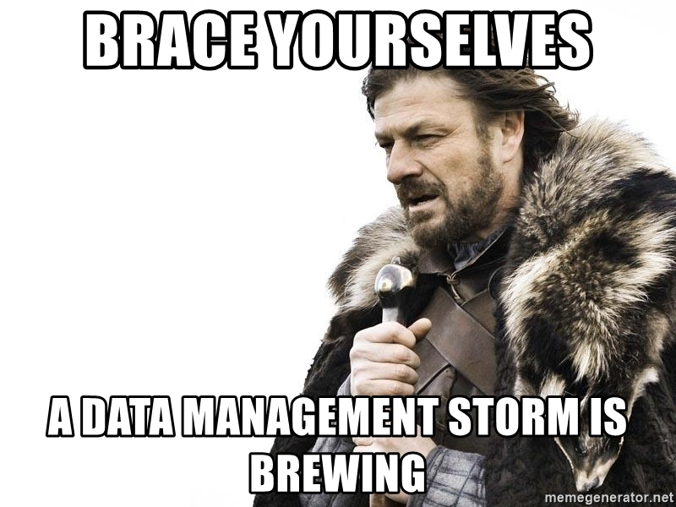
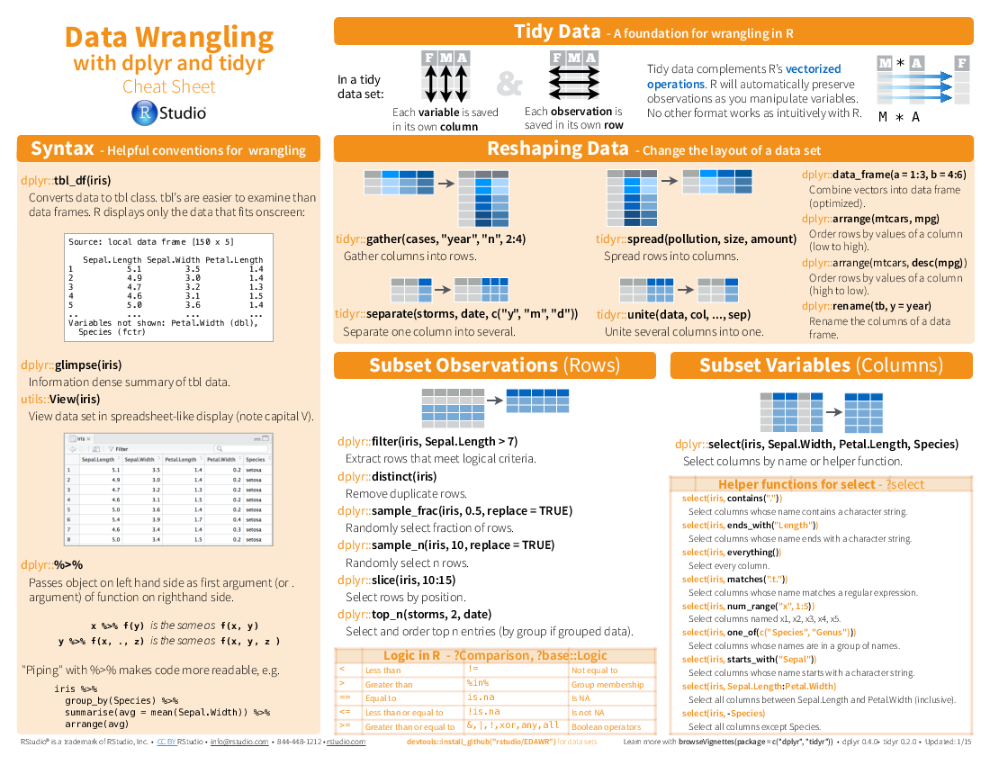
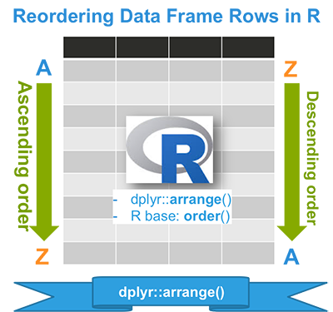
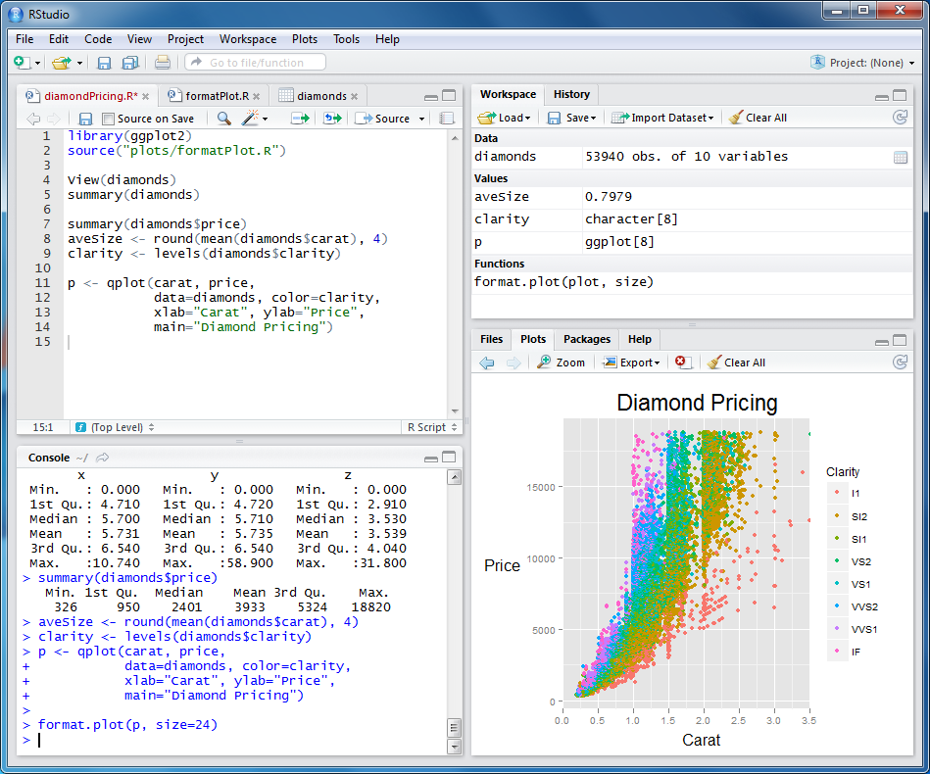
Welcome

Slide 3
Pre-training assessment

Slide 4
Pre-training assessment: Please rank your skill level using R/RStudio for:
Notes:
-address what string data is compared to numeric/double/integer
-most people are beginner/no idea for all topics
-setting working directory/installing packages has most competency

Slide 5
Pre-training assessment: Biggest Fears with learning R?
Doing inaccurate data manipulation
Rusty programming skills
Complex material
Not understanding enough to do independently
Forgetting it quickly

Slide 6
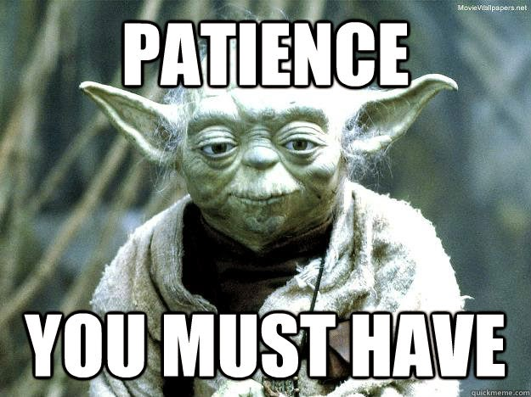
Don’t Worry
We will:
Showcase an easy-to-learn package
Familiarize through exercises
Practice, practice, practice!

Slide 7
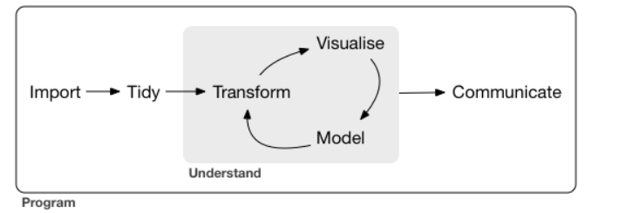
Training Approach
This training will teach data management principles & data visualization methods in R
Slides ->
Example R script ->
Exercise R script

Slide 8
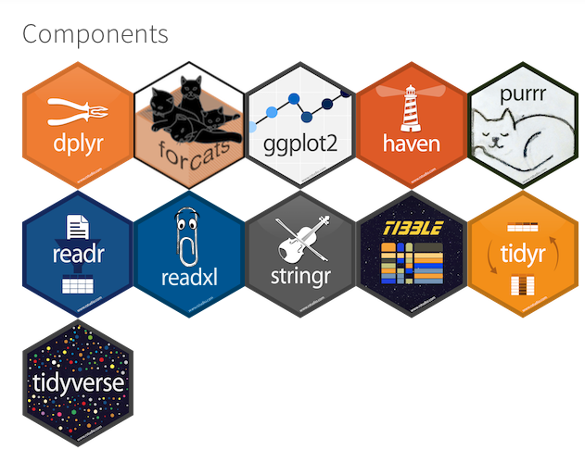
Training Approach
Tidyverse suite of packages:
Reproducibility
Consistency
Ease of Use
Notes:
Tidyverse shares common design philosophy – goes through structured workflows and creates highly reproducible code
Easier to learn than Base R for beginners for this reason

Slide 9
At the end of Session 1, you will know how to:
Navigate the RStudio interface
Load R packages
Import .txt or csv datasets
Explore datasets
Sort variables
Subset the data
Export datasets into .txt or csv
Know what a “Tidy” dataset is

Slide 10

Notes:
Let’s talk about Rstudio for a second

Slide 11
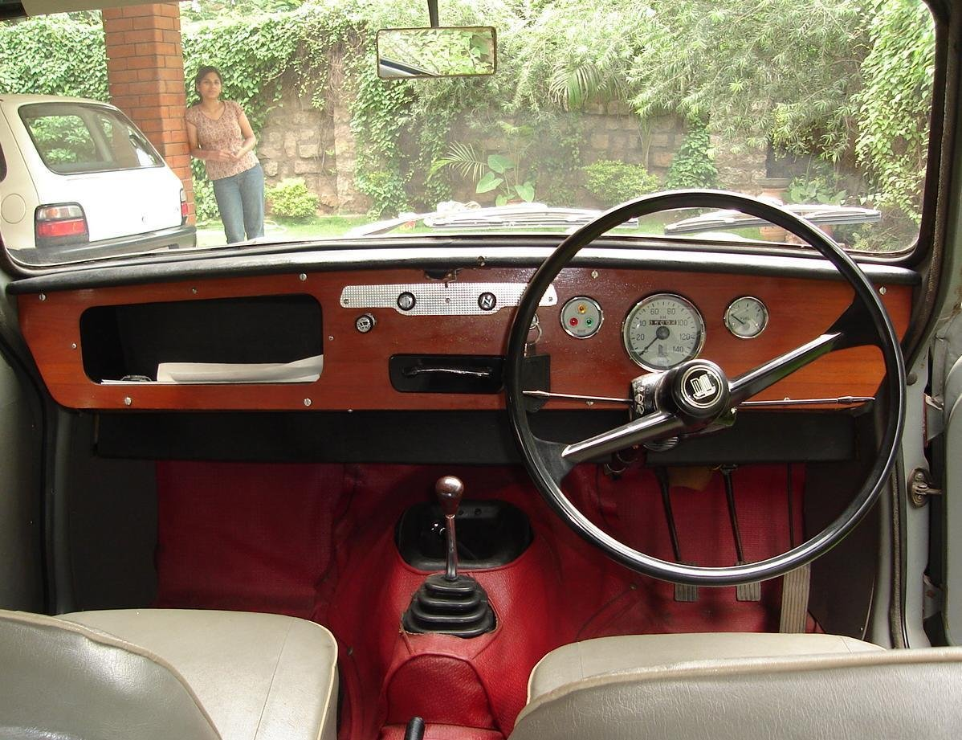
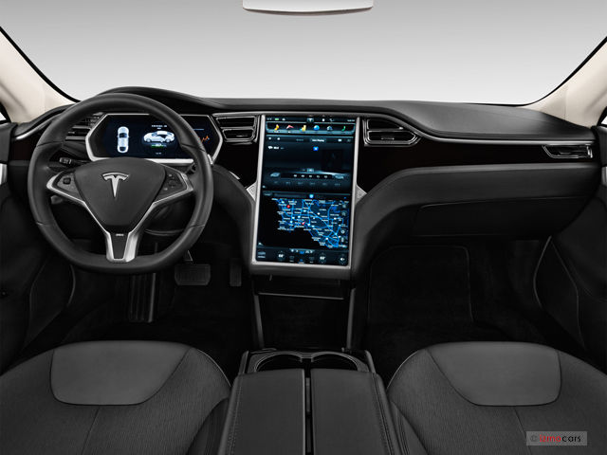
What is RStudio?
“R” refers to software and programming language
RStudio is the Interactive Development Environment for R (a cool interface)
Open source, free software
‘Packages’ created by the community can do almost anything
Notes:
Not going to walk about the why. Everyone is here so they all think it is important already. Instead talk about the what
Pictures: tesla depicts: user friendliness, comfort, elegance, and multi functional

Slide 12
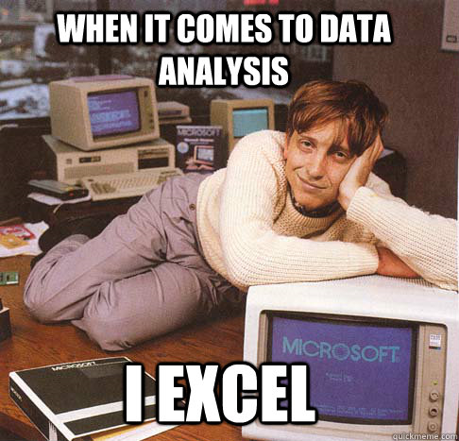
But…
Notes:
Let’s talk about excel for a second….

Slide 13
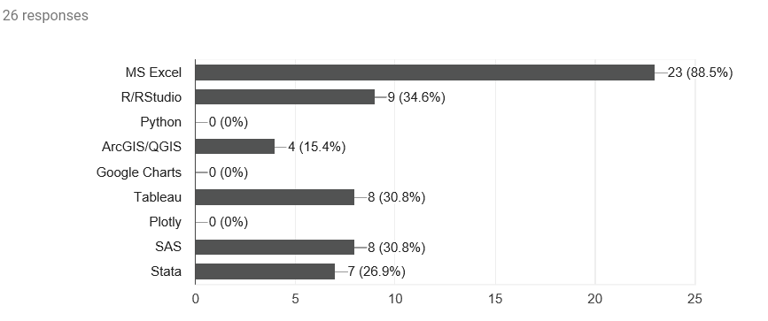
What software do you use for managing data?
Notes:
Excel is most common tool used for data management by participants
Argue that excel is not best platform for data management

Slide 14
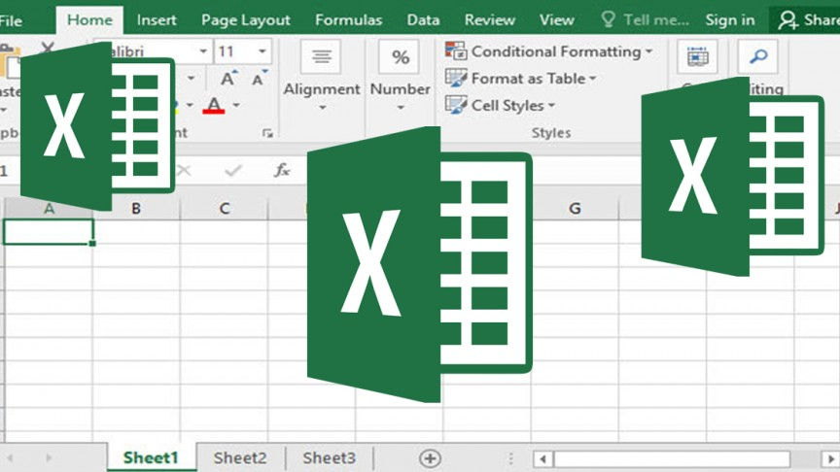
RStudio & Excel
Excel
Data in spreadsheet form
Formulas share space with viz
Outputs live in a workbook
Rstudio:
Data in data structure
Formulas and code live in a script file
Outputs live in the environment
Notes:
Code:
In excel, Sometimes it can make your calculation look like the original data and create confusion for your stakeholders.
Output:
In Excel, results and calculations live in a worksheet in a workbook. It can be easy to confuse with the original data, it’s hard to check if things are correct and re-running analyses (you often re-run them!) is time consuming.
In R, if you give your result or analysis a name, it will be in the Environment, waiting for you – you can print it, copy it, change it, chart it, write it out to Excel for a coworker and recreate it any time you need with your script.

Slide 15
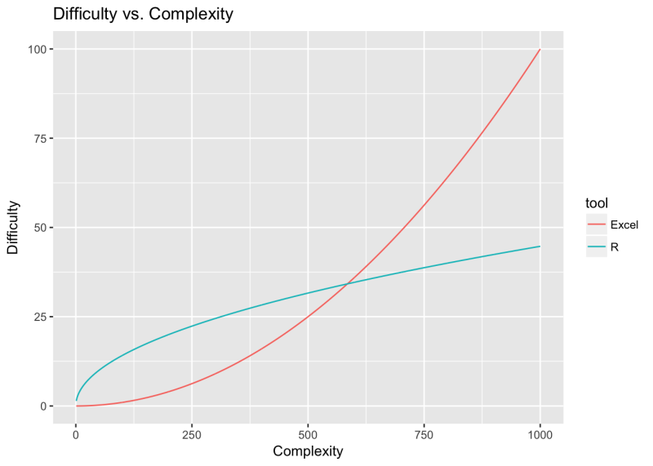
RStudio and Excel
http://rex-analytics.com/things-live-r-r-excel-users/
https://www.jessesadler.com/post/excel-vs-r/

Slide 16
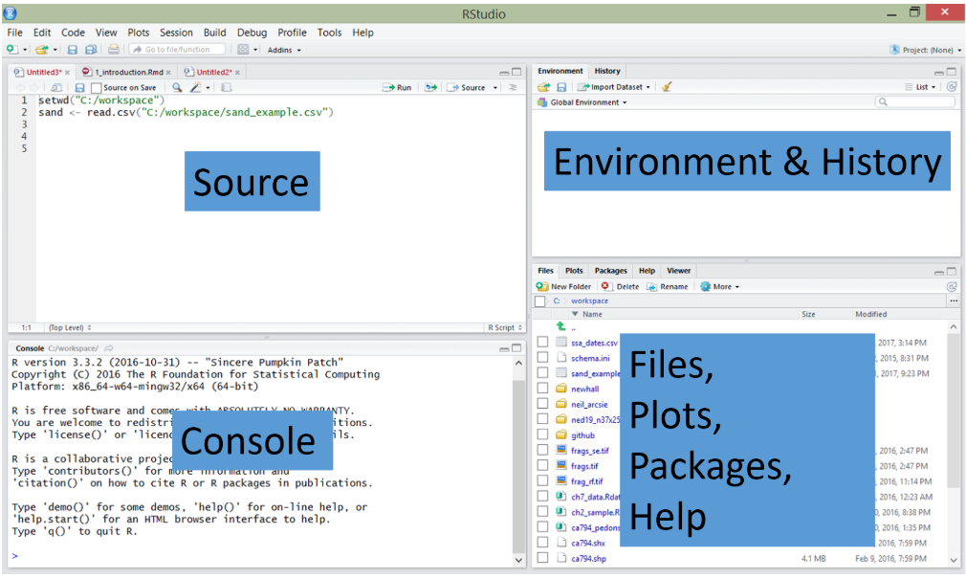
RStudio Default Interface
Notes:
Source: Where code is written, edited, and ran (where you will be writing your code)
Console: where any code results appear
Environment & History: where R objects are stored; where history of key strokes are recorded
Output Window: Viewing graphical outputs, files, folders, packages, help documentation

Slide 17
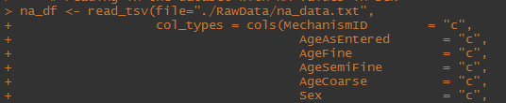
Tips and Quirks
You can type or copy and paste commands
R is case sensitive
plus sign + in the command line means incomplete code
Basic format of a function: function.name(argument, options)
Use ‘#’ to comment out code (must precede code)
Use of ‘<-’ instead of ‘=‘
Forward slash required for file paths

Slide 18
Assumptions
R and RStudio installed and working on your laptops
Have an interest in learning how to manage data in R environment
Downloaded and stored the R files needed
Have completed the R pre work exercise
Maybe haven’t even looked at the pre work
May not even know about pre work
Let’s get started!

Slide 19

IT Check: Download & Open Files
Find the R training files on your computer
Download here if not already done so: https://github.com/ICPI/R-Training
Double click on the R session 1 script file
RStudio should automatically open with the script
Raise your hand for help, if needed

Slide 20
R Packages
Packages are the fundamental units of reproducible R code
A package bundles together code, data, documentation, and tests
Created by R practitioners
Increases the power of R
Over 10,000 packages in the wild
install.packages(“X”)
library(X)
Learn more: https://www.datacamp.com/community/tutorials/r-packages-guide#what
Notes:
Provide use case for need of a package: need to create interactive map, automate importing MSD, data mine text data
Show this slide before starting script

Slide 21

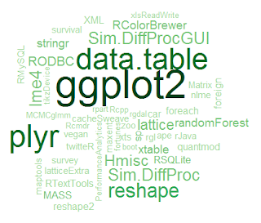
R Packages
In the Wild:
In this training:

Slide 22
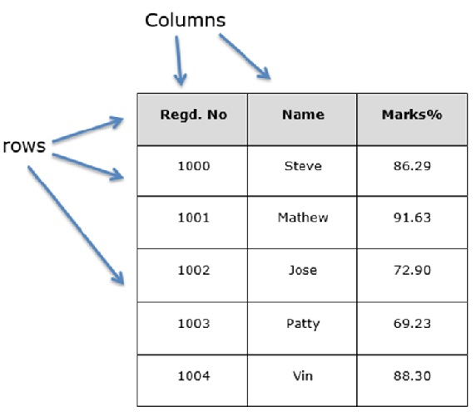
Data Frame
A data frame keeps data in rows and columns, similar to a spreadsheet or a table in SQL.
Most data analyses in R and all data used in this training will use data frames.
Rows = observations, columns = variables
Notes:
Show this slide after importing first dataset

Slide 23
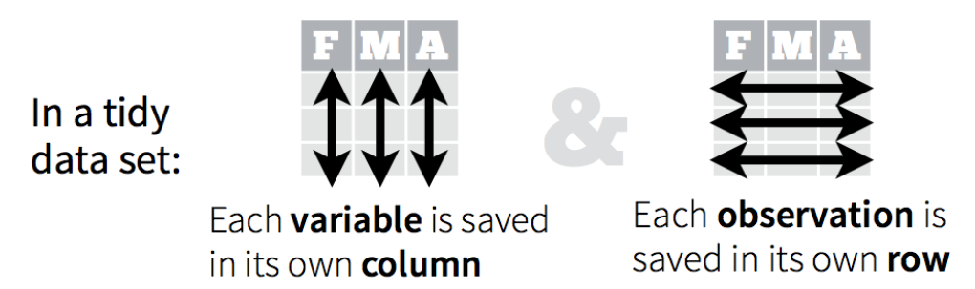
What is “Tidy” Data?
Tidy datasets satisfy these conditions:
observations are in rows
variables are in columns
contained in a single dataset.
Tidy data makes it easy to carry out data analysis.
Notes:
Haven’t decided when to bring this up yet

Slide 24
Sorting Data
arrange ()
Arrange is a dplyr function used to sort a column in a particular order.
Use desc to sort in descending order
arrange (data, ordering_column)
arrange (data, desc(ordering_column))

Slide 25
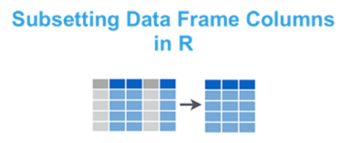
Subset variables
select ()
Only a few variables are of interest
Select function allows for subsetting by those variables
select (data, column1, column2, etc)
select (data, column1:column10)

Slide 26
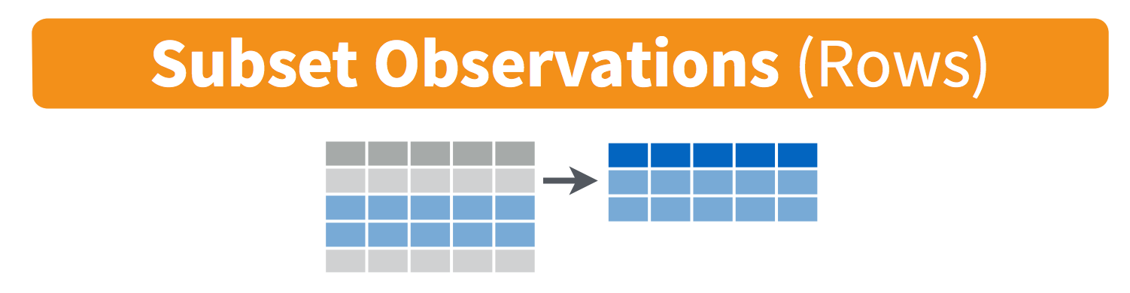
filter ()
Only a few conditions or rows are of interest
Filter function allows for subsetting columns for those conditions
Multiple conditions can be specified
filter (data, column1 == value)

Slide 27
This concludes Session 1
Time for a break
Session 2 begins after the break……

Slide 28
Session 2
Recap exercise on Session 1 lessons
More data management methods
Culmination exercise
Then eventually you can go home

Slide 29
At the end of Session 2, you will know how to:
Create new variables
Clean up erroneous values
Rename variables
Delete variables
Pipe (%>%)
Summarize data like pivot tables
Stack/merge datasets

Slide 30
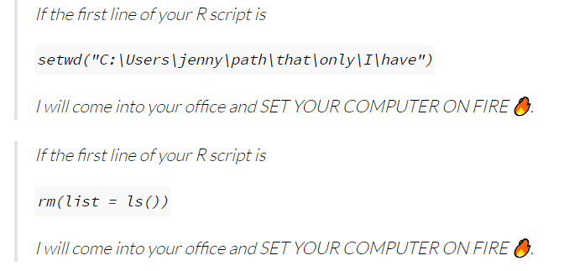
Managing work-flow
Jenny Brian, RStudio Team

Slide 31
Why care about work-flow?
Eventually you will need to quit R to do something else or
Run scripts for >1 projects at a time and know which window is doing what or
Know where the scripts & outputs are being saved or
Share your code/projects with colleagues

Slide 32
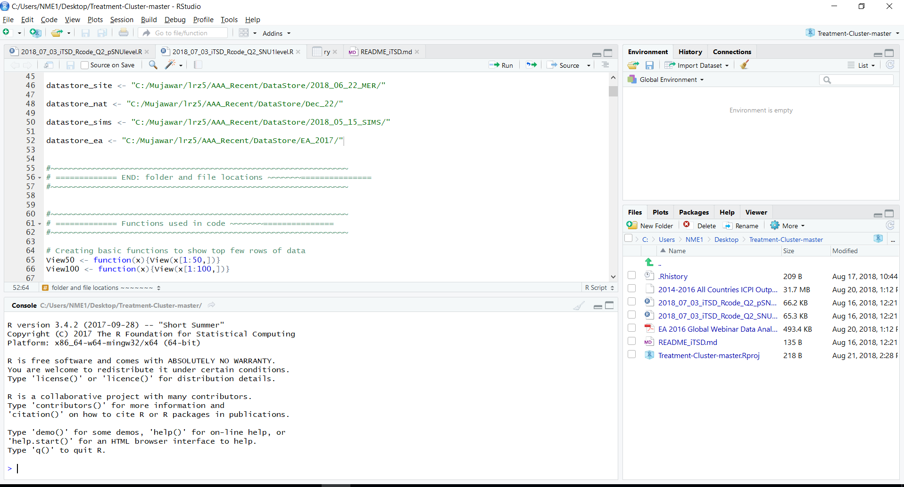
Workspace
Just an instance of RStudio
Opens the last instance before closing
Autosaved in .Rhistory file

Slide 33
Working Directory (wd)
Default reference for input & output files.
Default wd - where R is installed.
getwd() – shows current wd
setwd(‘:C/xyz/abc’) – set wd to a specific folder
Changing this would save all your files ‘abc’
You will not have to specify path to any files inside this folder
read_tsv(‘site_im.txt’) instead of read_tsv(‘:C/xyz/abc/site_im.txt’)

Slide 34
R Projects & workflow management
.Rproj - instance of RStudio associated with its own wd
You don’t have to getwd() or setwd()
Each Project & its encasing folder (wd) can be associated with a workstream, contain all relevant rscripts, txt files
Work in multiple RStudio sessions simultaneously
Portable - zip and share the project folder with anyone

Slide 35
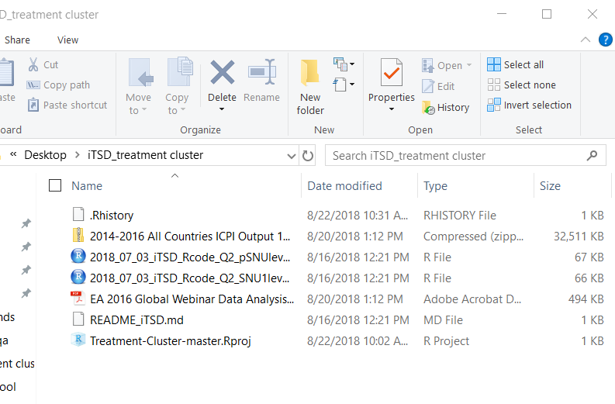
R project folder (.Rproj)
iTSD_Treatment cluster is automatically the working directory as it contains the .Rproj file
.Rproj file – click this, not the scripts to start the RStudio session
Create .Rproj for each of your projects in different folders to better manage workflow

Slide 36
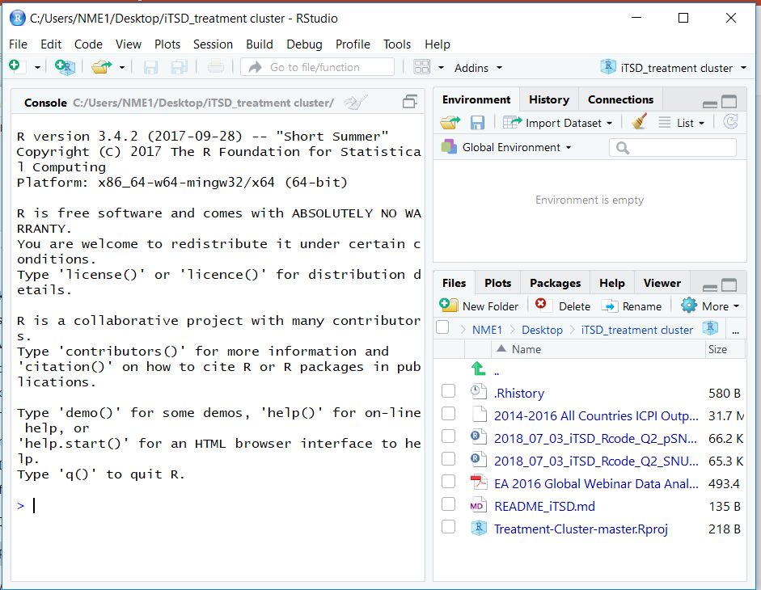
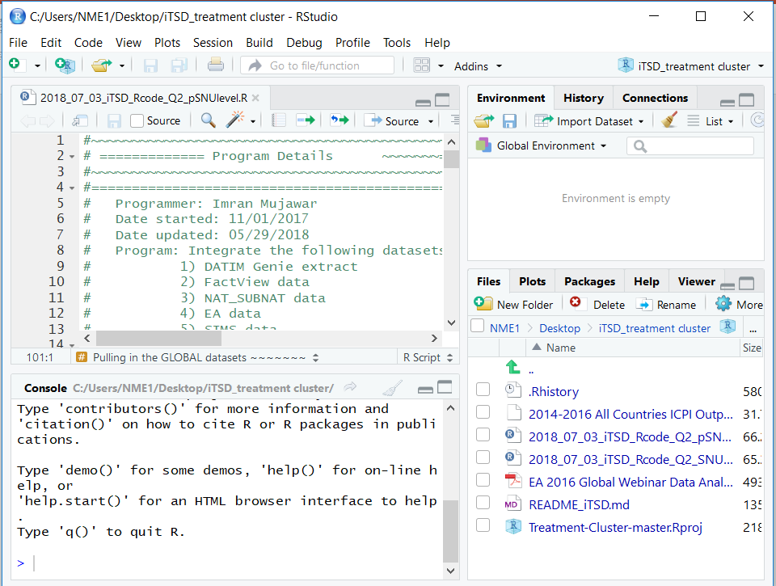
Inside .Rproj
Once Rstudio opens, click on the scripts here to open them inside the workspace
Automatically shows the working directory and its contents (can’t open data files by clicking here)

Slide 37
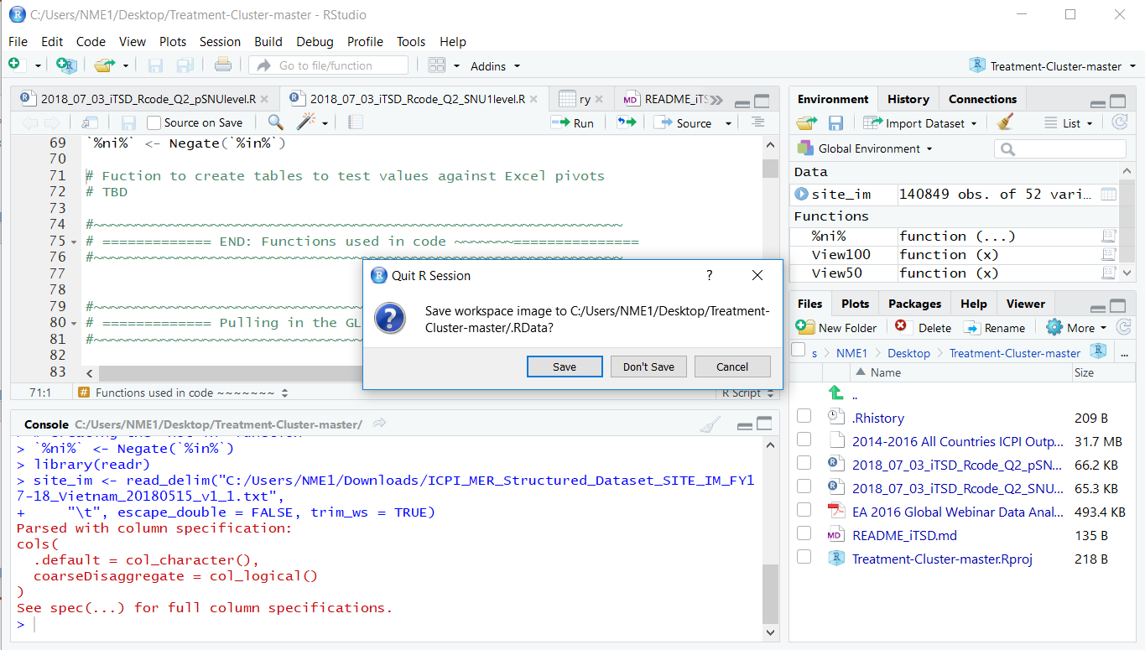
Quitting RStudio session
If you save workspace image, next time you open this RStudio project it will look exactly the same including objects in Environment. These objects will be saved as .Rdata file in the working directory.
Save your scripts
Share .Rproj files with updated scripts
Think about whether or not to save workspace
Notes:
If you save workspace:
Easy but bad
.Rdata files are huge
Go corrupt overtime and the entire .Rproj fails to start

Slide 38
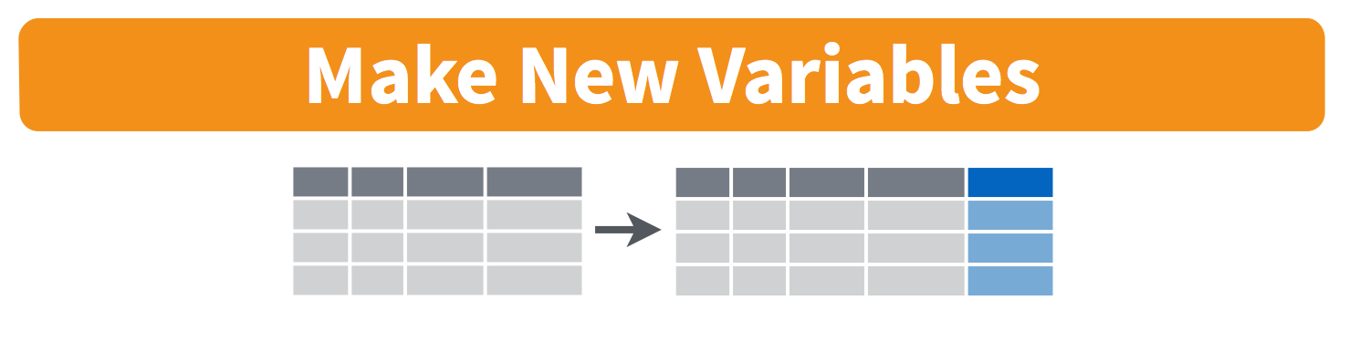
mutate ()
Adds new variables based on existing variables
mutate (data, new_column = column1/10)
mutate (data, new_column = column5 * 10)

Slide 39

This concludes Session 2
In the near future:
Session 3 will cover advanced topics
Please let us know in the Eval if you would like to see any particular topics
Session 4 will cover data visualization
ggplot2 package

Slide 40
Resources
ICPI R Users Slack Channel – post any Q’s here
ICPI R Wiki Repo
Dplyr training
DataCamp
Data Wrangling Cheatsheet
R for Data Science - Hadley Wickham

Slide 41

Recognition
ICPI Leadership
DIV
ICEE
Facilitators
Presenters
All of you brave participants

Slide 42

Happy Data Managing
For any questions, please contact ICPI@state.gov

Slide 43


Discussion & Evaluation
https://goo.gl/forms/fmymQHflGxjlzTB22

